Slide 1
2022-2023 Annual Title I Meeting
Frost Elementary School
Principal: Tiffaney Mikell
Assistant Principal: Temeka Lewis
Date: 10/6/2022

Slide 2
Agenda
What is Title I?
Parent & Family Engagement Plan
Parent-School Compact
School Achievement Data
Title I Funds/Involvement
Important Dates/Feedback

Slide 3
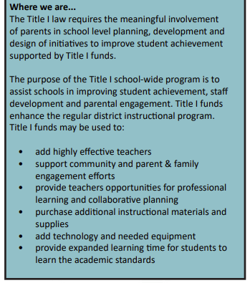
What is Title I?

Slide 4
Frost Elementary Parent & Family Engagement Plan
Every Title I school, in collaboration with parents, must develop a school parent involvement plan.
The plan describes how the school will engage the families in an organized, ongoing, and timely way in the planning, review and improvement of the Title I program at the school.
A copy of the plan is on the school’s website, in the Parent Information Notebook in the front office and available on our school website for viewing.

Slide 5
School Compact
A written agreement that outlines how the parents, the entire staff and the students will share the responsibility for improved student academic achievement, as well as describes how the school and parents will build and develop a partnership that will help children achieve the state’s high standards.
(Was sent home in the first day packets)

Slide 6
School Achievement Data
2021-2022 FSA Proficiency Data
46% of students in Grades 3-5 were proficient in ELA
47% of students in Grades 3-5 were proficient in Math
43% of students in Grade 5 were proficient in Science
Frost Elementary 2021-2022 School Grade was a C

Slide 7
Title I Funds in Our School
Program Funds
Resource Teachers
Materials
Curriculum
Technology
How Can You Help Decide How Funds are Spent?
Project Application Survey
Join SAC

Slide 8
Important Dates
2022-2023 School Event Calendar.pdf
We Value Your Feedback
Please complete 2022-203 Title 1 Project Application Stakeholder Survey being sent home with students
Please complete any Survey sent home via school links

