Slide 1
Growth, Access and Outcomes of US IB Schools and Students
Jen Merriman, Director, Research, Policy & Design
Ellen Sawtell, Senior Manager, Data Analytics & Innovation
Jarrett Stuart, Manager, Data Analytics & Innovation
David Weiss, Head, IB World Schools

Slide 2
New report announcement https://www.ibo.org/research/outcomes-research/continuum-studies/the-international-baccalaureate-in-the-united-states-growth-access-and-outcomes-2024/
Notes:
It is a first-of-its-kind that delves into the latest data related to IB participation and growth—particularly among traditionally underserved student populations—as well as research outcomes for IB students.
“In the United States, the IB exemplifies how high-quality, holistic and future-focused education can lead to success for students from diverse schools and communities nationwide. This report demonstrates that the IB is not just about academic rigor, but about creating opportunities that prepare all students to thrive in our increasingly complex and interconnected world. The data and research in this report makes it clear that all students, regardless of personal circumstances, can benefit from an IB education.”

Slide 3
Overview of Session
Value of an IB Education
Growth & Access Data
New Higher Education Outcomes Results
Discussion and Q&A

Slide 4
The Value of an IB Education

Slide 5
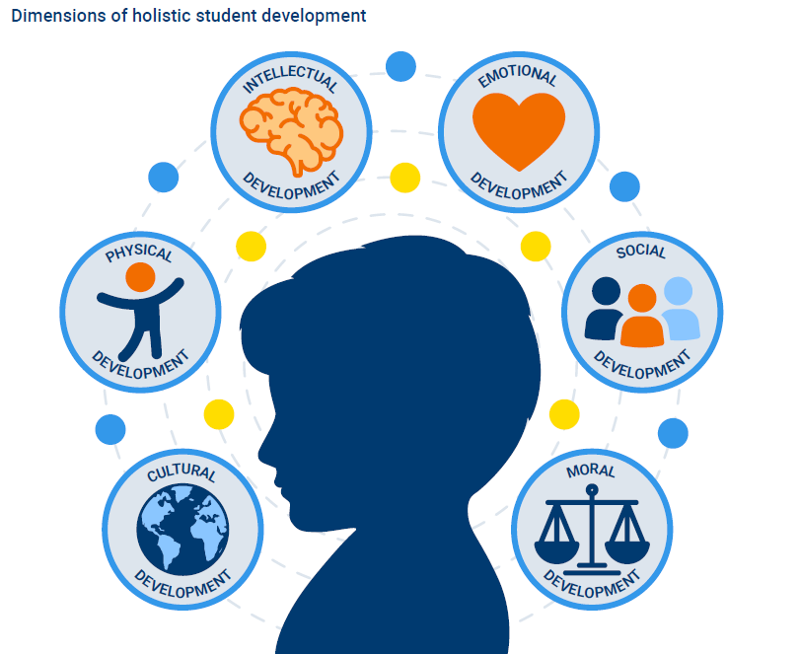
Brookings recognizes that the IB provides transformational education—setting high expectations for both academic learning and holistic student development
Brookings dimensions of holistic student development
Notes:
https://www.brookings.edu/articles/transforming-education-for-holistic-student-development/

Slide 6
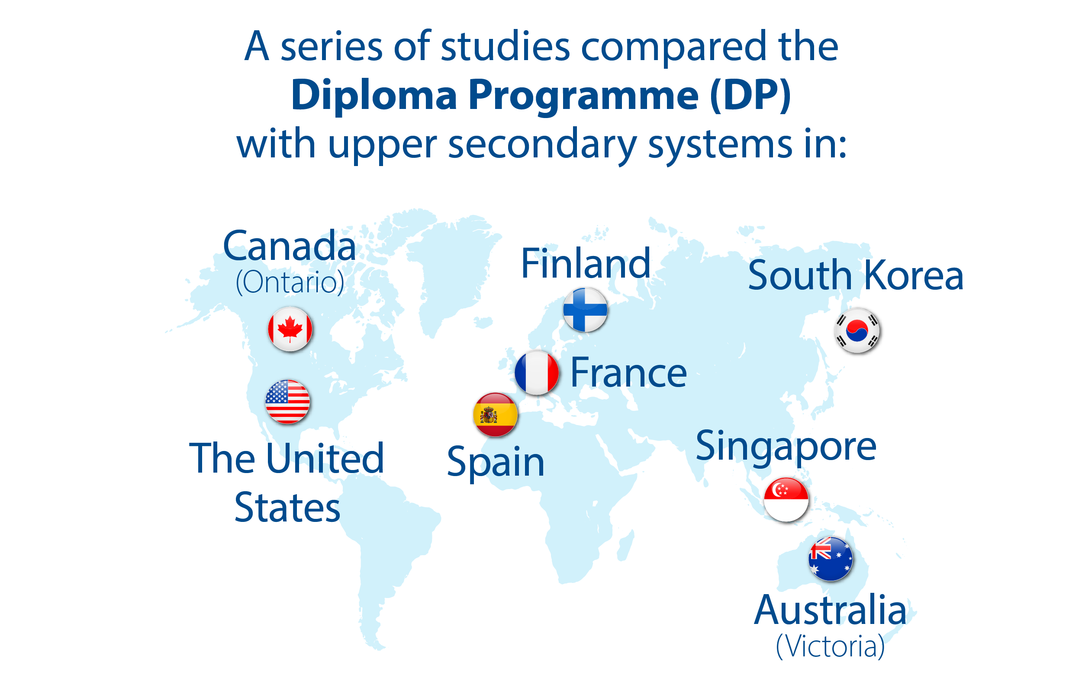
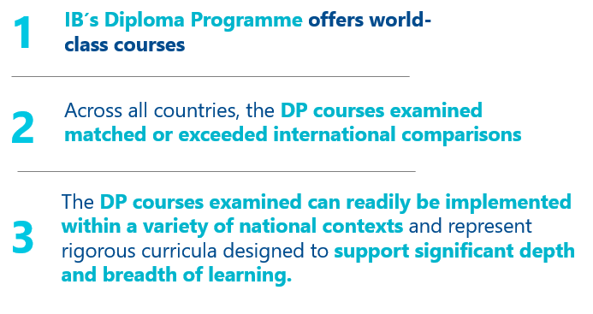
Rigorous Academic Learning
The DP offers world-class courses
Notes:
https://ibo.org/research/outcomes-research/myp-studies/performance-comparison-between-ib-and-non-ib-school-students-on-the-international-schools-assessment-2021/
There were no instances in which non-IB students significantly outperformed IB students at any grade level or domain
MYP students achieved better results than non-IB students on all academic domains at grade 9, with medium effect sizes.
MYP students: notable result for Scientific literacy at grade 10 (large effect size).

Slide 7
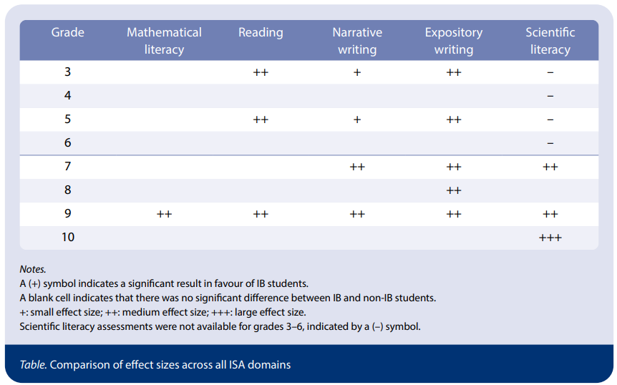
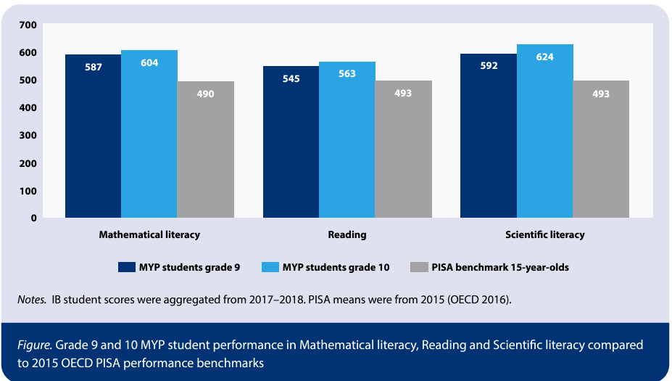
International Schools Assessment/PISA
On a global level, PYP and MYP students performed as well or better than students from non-IB schools in all subject areas and grade levels on the ISA
Further, MYP students' ISA scores were significantly higher than PISA benchmark scores in all three domains¹
¹The ISA scales are equated, and therefore results could be placed on a common scale and compared with the PISA scores.
Notes:
https://ibo.org/research/outcomes-research/myp-studies/performance-comparison-between-ib-and-non-ib-school-students-on-the-international-schools-assessment-2021/
There were no instances in which non-IB students significantly outperformed IB students at any grade level or domain
MYP students achieved better results than non-IB students on all academic domains at grade 9, with medium effect sizes.
MYP students: notable result for Scientific literacy at grade 10 (large effect size).

Slide 8
Competencies of the Future
The future of education requires a focus on key competencies that students will need to flourish, developing their uniquely human qualities that are unlikely to be replaced by technology.
The IB is investing in research to identify and explore crucial competencies for students' future success:
Notes:
https://ibo.org/research/curriculum-research/cross-programme/competencies-of-the-future/

Slide 9
IB is investing in supporting wellbeing through Research & Innovation
Student Wellbeing
Teacher Wellbeing
Whole School Ecosystem
Notes:
https://www.ibo.org/research/wellbeing-research/

Slide 10
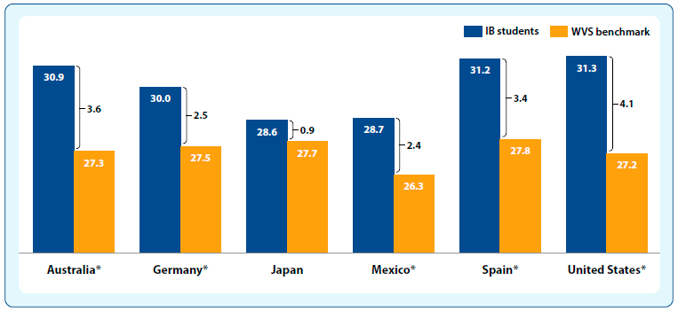
DP and CP students in six countries showed higher levels of global mindedness than young adults in the benchmark groups on the World Values Survey
*The WVS consists of nationally representative surveys conducted in almost 100 countries, which contain almost 90 percent of the world’s population, using a common questionnaire.
Notes:
https://ibo.org/research/outcomes-research/diploma-studies/global-mindedness-in-ib-schools-2021/
DP and CP students in all six countries showed higher levels of global mindedness than young adults in the benchmark groups (figure).
IB students’ global-mindedness levels were between 3% and 15% higher than the country-level benchmark.
Results were statistically significant for all countries except Japan (likely due to small samples in Japan).

Slide 11
Growth & Access Data

Slide 12
Definitions & comparative data sources
Graduating Class: Students who graduated in May / June of a given year; commonly thought of as 12th grade or seniors in the United States
National Center for Education Statistics (NCES): https://nces.ed.gov/
Common Core of Data (CCD) includes Public School data and
Private School Survey (PSS) data
Race/ethnicity data: Utilized NCES data by school composition
Proxies for income data:
Free or reduced-price lunch data from schools for the National School Lunch Program;
Title I eligibility status; funding for LEAs and schools with high volumes of children from low-income families
Notes:
LEA: Local Education Agency

Slide 13
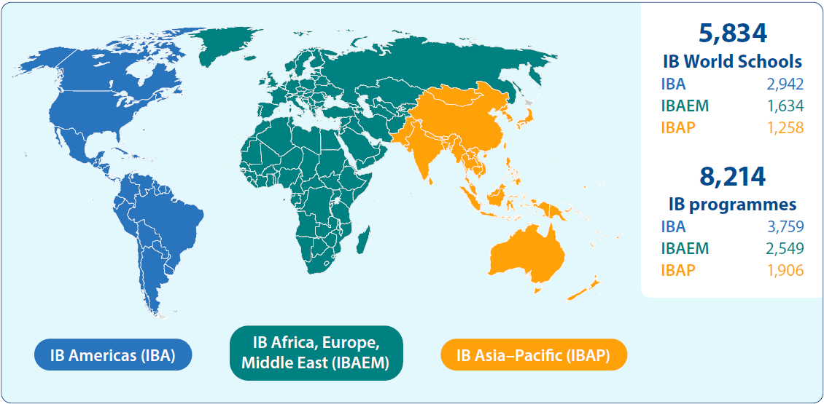
IB is currently offered in 161 countries globally

Slide 14
Top 10 Countries Offering IB by Program
Notes:
The United States currently has the largest number of schools and programs of any country.
IBA: US, Canada, Mexico
AP: China, India, Australia, Japan
AEM: Spain, UK, Turkiye

Slide 15
IB World Schools in the US
Notes:
IB programs are currently offered in 48 US states and Washington, DC, in 1,924 schools—notably, 89% of these IB World Schools are public schools. Just over half (51.7%) of IB World Schools in the United States are located in cities. Just over a third (36.7%) are in suburban areas and 12% are located in rural/town areas.

Slide 16
IB Students and Teachers
According to a recent IB survey of schools, the IB currently has over 65,000 dedicated teachers educating over 785,000 students in the United States
Notes:
The IB’s 4 programmes reaches hundreds of thousands of students and tens of thousands of teachers in the United States from Pre-K through Grade 12. The PYP develops students from Pre-K through 5th grade, the MYP from 6th grade to 10th grade, and the DP and CP for 11th and 12th grades.

Slide 17
IB Growth in the US
10-year change in authorized programs by US state
(public and private schools)
Over the last 10 years…
Nearly every state in the country experienced growth
39 states experienced IB program growth of more than 5%
6 states more than doubled both the number of IB programs and IB World Schools
Notes:
In the US, IB continues to grow both nationally and within states. Nationally, the number of IB programmes has grown from just over 1500 programmes in 2012-2013 to nearly 2500 programmes currently. At a state-level, nearly every state has experienced growth over the past 10 years. Here is a screenshot of a figure from our newly released report that shows the 10 year change in authorized IB programmes by state.
(6 states that more than doubled both authorized programmes and authorized schools are: Vermont, Nevada, Rhode Island, Illinois, Montana, and Iowa)

Slide 18
IB Program Highlights, by State
During the 2022-2023 school year:
California had the most schools authorized to offer the DP
Georgia and Illinois had the most schools authorized to offer the CP
Florida had the most schools authorized to offer the MYP
Texas had the most schools authorized to offer the PYP
Notes:
IB’s 4 programmes are well represented in states throughout the nation. California offers 113 DP programmes, Georgia and Illinois each offer 14 CP programmes, Florida has 69 MYP programmes, and Texas provides 83 PYP programmes.

Slide 19
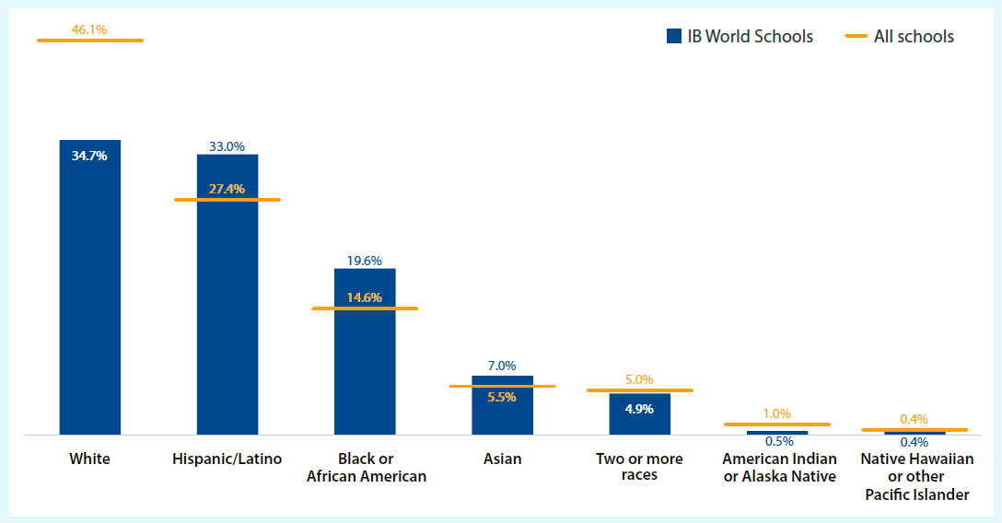
Access to IB in the US – by Race/Ethnicity
Percentage of school enrollment by race and ethnicity for all US schools compared to all US IB World Schools (school-level data), 2022-2023
Compared to enrollment percentages at all US schools…
US IB World Schools have greater percentages of students from traditionally underserved racial and ethnic groups, such as Hispanic or Latino and Black or African American students
Notes:
While there is not sufficient data to determine precisely who can access IB programs, the best possible approximation of racial and ethnic groups for IB students in the US comes from enrollment data at IB World Schools in the US. For public schools we can source these enrollment data from the NCES Common Core of Data. For private schools, we can source these enrollment data from the Private School Survey. These approximations can be compared against the distribution in all US schools to estimate the availability of an IB education for diverse student groups.
(For US Public Schools, IB’s response race for race/ethnicity data of students who take our assessments is only about 40%)

Slide 20
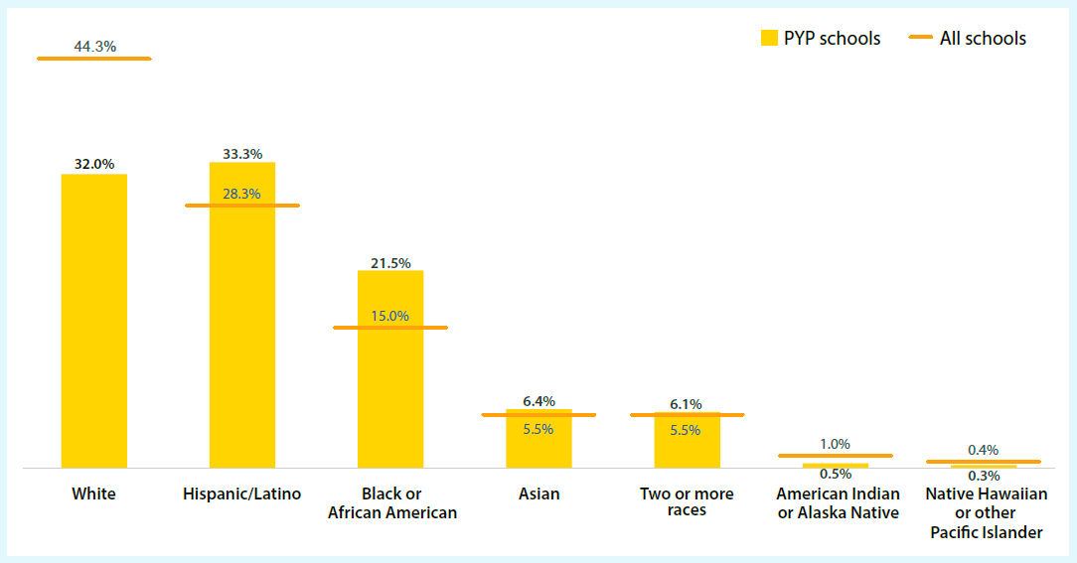
Access to PYP in the US – by Race/Ethnicity
Percentage of enrollments by race and ethnicity for all US primary schools compared to all US schools offering the PYP (PYP student-level data), 2022-2023
As with IB World Schools in the US, PYP schools have greater percentages of students from traditionally underserved racial and ethnic groups than US primary schools overall
Notes:
We recognize that not all students at IB World Schools necessarily participate in the available IB programmes, and we wanted to understand better the race/ethnicity composition within our IB classrooms. The PYP is delivered as a whole-school program, meaning all students in the school take the PYP so we can accurately estimated student enrollments by race and ethnicity.

Slide 21
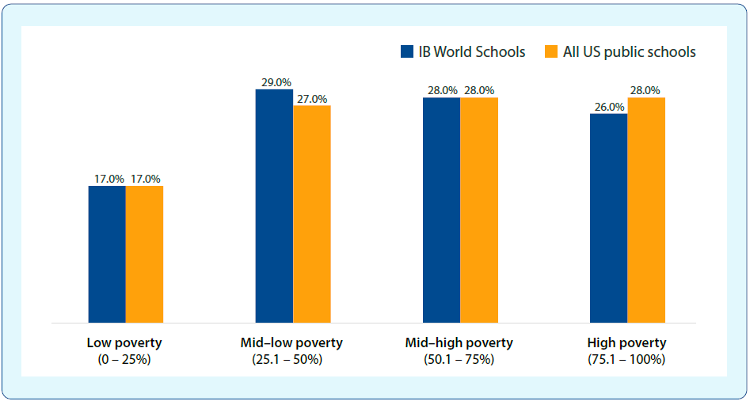
Access to IB in the US – by Poverty Groups
Percent of all US public schools and IB US public schools by poverty levels, 2022-2023
The socioeconomic status of IB World Schools closely mirrors the proportion nationally.
Notes:
Using free or reduced-price lunch data from schools for the National School Lunch Program can help understand the poverty status level of schools nationally and within our IB schools.
We didn’t show it here, but you can see in the report where we use Title I eligibility status to understand the socioeconomic level of students at schools nationally and compare to our IB schools.
Eligible for Schoolwide Program: 59% all US vs. 56% IBWS
Eligible for Targeted Assistance School Program: 12% all US vs. 9% IBWS

Slide 22
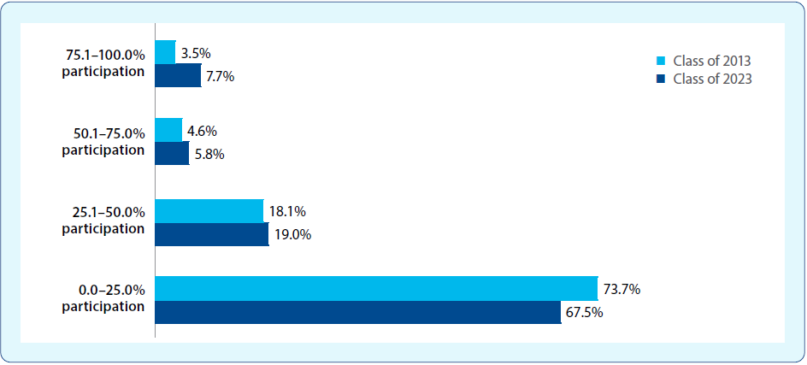
DP Exam Participation Rates in IB World Schools
Over the past 10 years, the percentage of public schools offering the DP that had more than half of their graduating class take at least one DP examination grew from 8.1% in 2013 to 13.5% in 2023
Share of US public schools offering the DP by percentage of graduating class taking at least one DP examination
Notes:
Over the past 10 years, at US public schools offering the DP, the percentage of high school graduates who took at least one DP course increased from 16.6% to 18.9%, essentially shifting from 1 in 6 students to 1 in 5 students.
Furthermore, by classifying school participation rates into 4 groups reveals greater insight into the DP participation rate patterns at US public IB World Schools and its subsequent growth over the past 10 years.

Slide 23
DP/CP Exam Trends for US 2023 HS Graduates
Top 10 Subjects
Notes:
Students choose DP courses across six subject groups: studies in language and literature, language acquisition, individuals and societies, sciences, mathematics, and arts. Courses are offered at either a high level or standard level, which differ in scope but are measured according to the same grade descriptors. SL courses are recommended to have at least 150 hours of instructional time, and HL courses are recommended to have at least 240 instructional hours. Students pursuing the full DP diploma must take either 3 or 4 of their six subjects at a Higher Level (HL). IB students in the US 2023 graduating class of high school took exams in over 100 IB subjects. Here are the 10 most popular. If interested in seeing a longer list of most popular subjects please see the full report online.

Slide 24
DP Subject Group Highlights – US 2023 HS Graduates
Studies in language and literature
47 different subject examinations were taken by the US 2023 high-school graduating class
Sciences
63% of biology exams were taken at HL compared with 41% of physics and 39% of chemistry examinations
Language acquisition
26 different subject examinations were taken by the US 2023 high-school graduating class
Mathematics
92% of Mathematics: applications and interpretation examinations were taken at a SL
Individuals and societies
90% of history examinations were taken at HL
Arts
46% of students pursuing the DP diploma elected to take an arts course (SL or HL)
Notes:
Here are some interesting facts and highlights from each of the 6 subject group areas. Students pursuing the DP diploma can choose an additional science, individuals and societies, or languages course instead of an arts course. The split of those choosing an arts course as opposed to an additional science, individuals and societies, or language course is about 50/50.
Of the 47 subjects in the studies in language and literature subject group, the overwhelming majority (97%) were either English A literature or English A language and literature.
Of the 26 subjects in the language acquisition subject group, the most popular 3 subjects (86%) were Spanish B, French, or Spanish ab initio.
Mathematics: applications and interpretation surpassed Mathematics: analysis and approaches in popularity and is mostly taken at a standard level. Mathematics: analysis and approaches is also more
likely to be taken at a standard level (73%).
Highlight Language, large modal %s

Slide 25
Overview of IB transcript sends
Based on data from the 2023 US high-school graduating class:
46,673 students sent IB examination scores to 2,117 institutions, which included 55,921 transcripts containing 261,005 examination scores.

Slide 26
Florida Universities Receive the Most Score Sends
The University of Florida received the most IB examination scores (8,764). The four most popular institutions are in Florida:
University of Florida
University of Central Florida
University of South Florida
Florida State University
Due largely to the Florida Bright Futures Scholarship program that provides full funding for a degree at any of the State University System of Florida universities for Florida students who are awarded the IB diploma.
Notes:
Why FL? Completing the IB program would get you the diploma

Slide 27
Eight additional states are represented in the Top 15 college score destinations
Rounding out the top 15 colleges and universities where IB examination scores are sent from the US 2023 high-school graduating class:
University of Michigan, Ann Arbor
University of Texas at Austin
University of Georgia
University of Washington, Seattle
University of Virginia
University of Colorado, Boulder
University of California, San Diego
University of California, Los Angeles
University of North Carolina at Chapel Hill
Texas A&M University, College Station
Georgia Institute of Technology
Notes:
Top 50 list has 22 states:
CA has 9 colleges/universities followed by
VA with 6
FL with 5 and
TX with 4

Slide 28
New Higher Education Outcomes Results

Slide 29
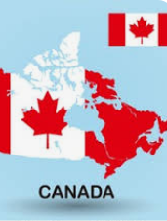
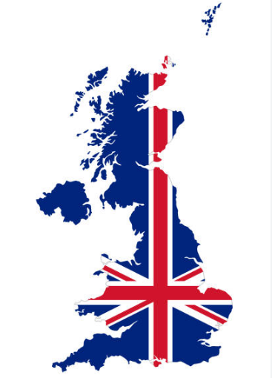
Prior DP Higher Education Outcomes

Slide 30
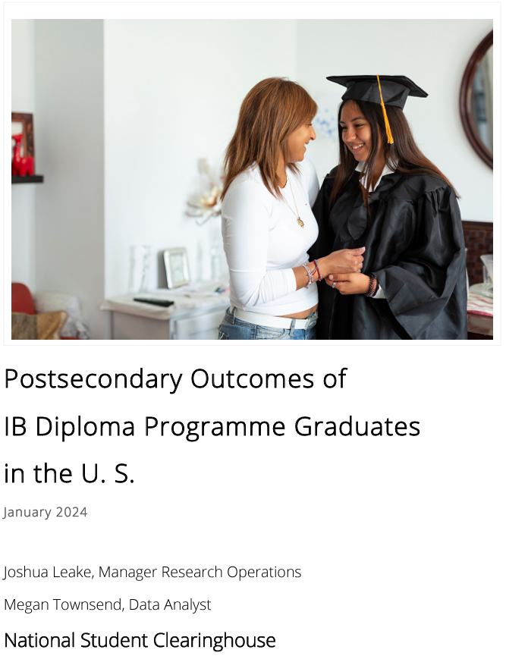
Tracked all DP and CP students who graduated in 2016
Two New US Studies
n = 51,609 n = 706
Notes:
https://www.ibo.org/research/outcomes-research/diploma-studies/postsecondary-outcomes-of-dp-graduates-in-the-united-states/
https://www.ibo.org/research/outcomes-research/cp-studies/postsecondary-outcomes-of-cp-graduates-in-the-united-states/

Slide 31
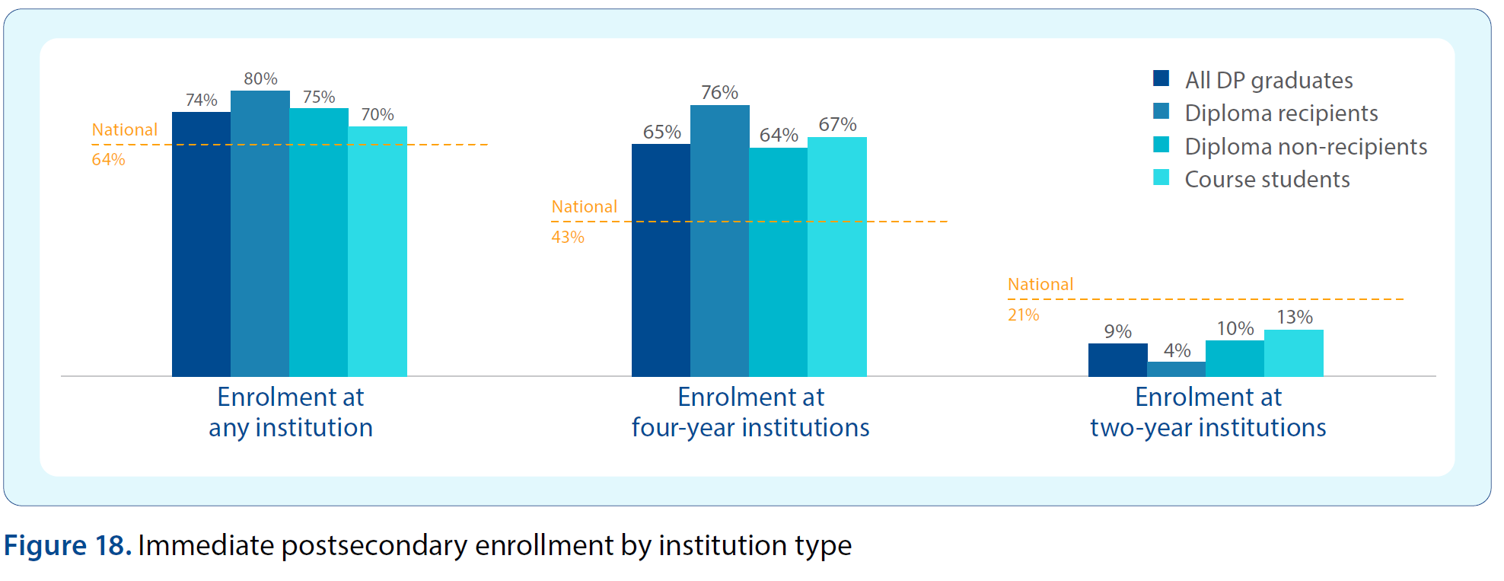
DP graduates show higher enrollment than the national average

Slide 32
US DP graduates enroll most often in “More selective" universities, the highest tier of Carnegie classification

Slide 33
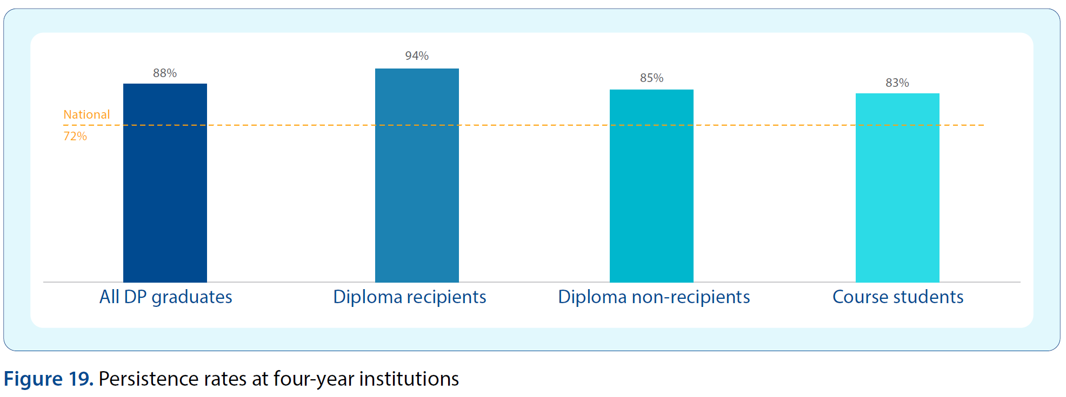
DP graduates show higher persistence than the national average

Slide 34
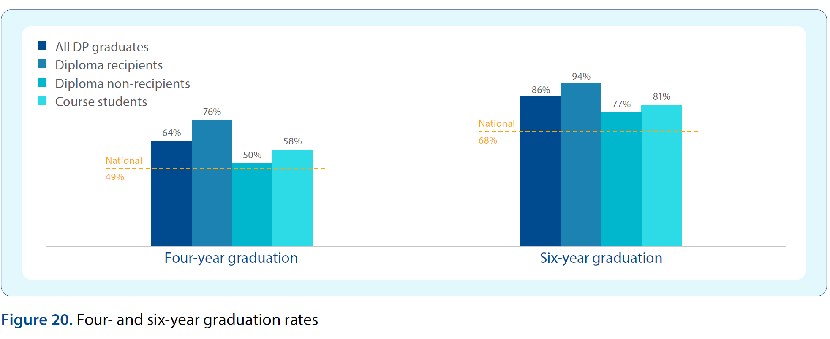
DP graduates show higher graduations rates than the national average

Slide 35
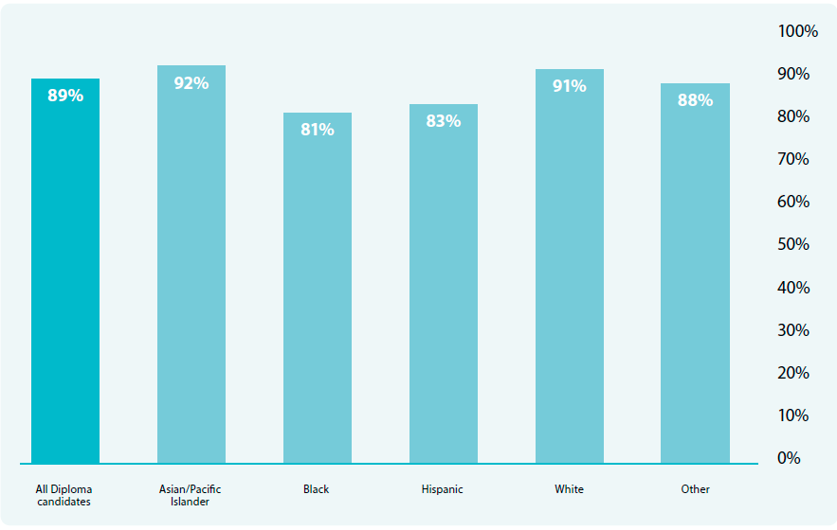
US DP CANDIDATES (who pursued an IB diploma) graduated in six years at substantially higher rates than the corresponding racial and ethnic groups nationally
Asian: 92% for DP candidates compared with 78% nationally
Black: 81% for DP candidates compared with 46% nationally
Hispanic: 83% for DP candidates compared with 59% nationally
White: 91% for DP candidates compared with 68% nationally
Source for the national cohort rates: 2023 NCES Digest of Education Statistics. Racial and ethnic categories differ between NSC and NCES data.

Slide 36
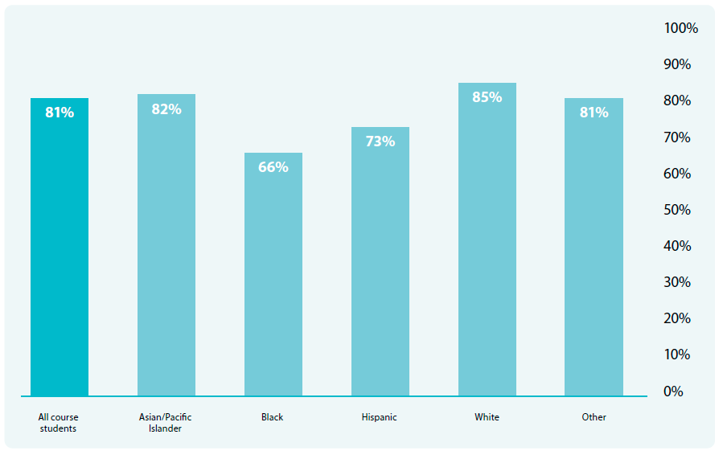
US DP COURSE STUDENTS outperformed the national six-year graduation rate for the corresponding racial and ethnic groups
Asian: 82% for DP course students compared with 78% nationally
Black: 66% for DP course students compared with 46% nationally
Hispanic: 73% for DP course students compared with 59% nationally
White: 85% for DP course students compared with 68% nationally
Source for the national cohort rates: 2023 NCES Digest of Education Statistics. Racial and ethnic categories differ between NSC and NCES data.

Slide 37
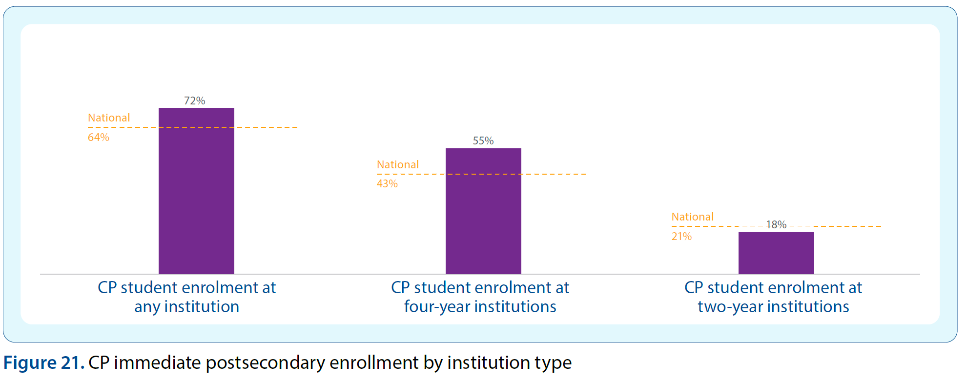
CP graduates show higher enrollment than the national average
Notes:
N=706

Slide 38
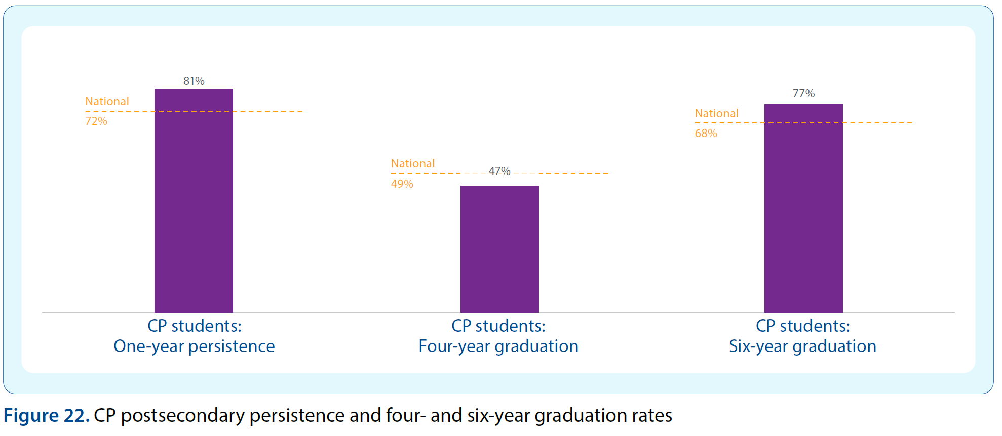
CP graduates show higher persistence & 6-year graduation rates than the national average

Slide 39
CP graduates tend to enroll in “More Selective” or “Selective” institutions

Slide 40
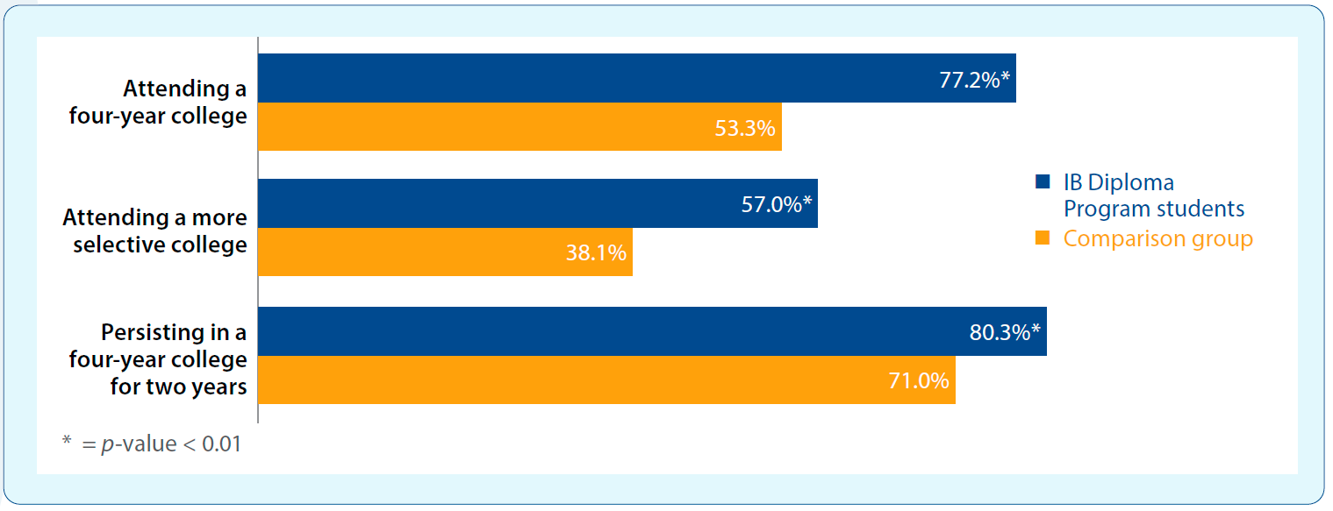
DP students from predominantly historically underserved groups—for example, students from low-income households or families with little to no history of college-going—were more likely to attend and persist in four-year colleges and to choose a more selective college than similar non-IB students.
Notes:
https://www.ibo.org/research/outcomes-research/diploma-studies/working-to-my-potential-experience-of-cps-students-in-the-ib-diploma-programme-2012/

Slide 41
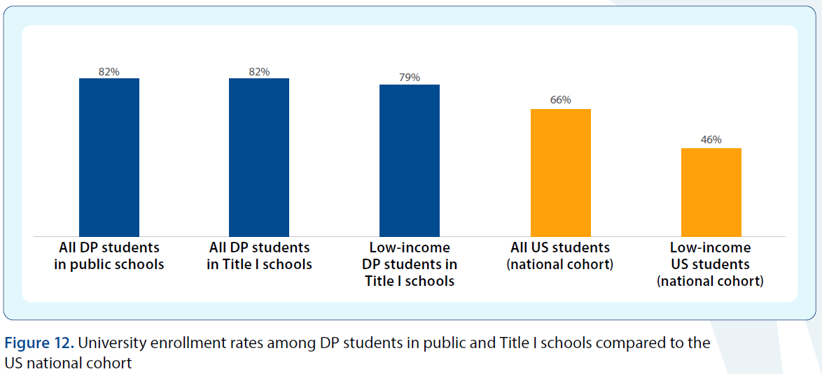
DP students attending Title I schools in the US enroll in college at much higher rates than national averages
Notes:
https://www.ibo.org/research/outcomes-research/diploma-studies/international-baccalaureate-programmes-in-title-i-schools-in-the-united-states-accessibility-participation-and-university-enrollment-2015/

Slide 42
Discussion
What struck you as new information or information you feel is important for your school community to know?
Was there any information presented that you can use to shape the value proposition for an IB Education?
How will you share it?

Slide 43
Access to IB in the US – by Race/Ethnicity
Percentage of school enrollment by race and ethnicity for all US schools compared to all US IB World Schools (school-level data), 2022-2023
Compared to enrollment percentages at all US schools…
US IB World Schools have greater percentages of students from traditionally underserved racial and ethnic groups, such as Hispanic or Latino and Black or African American students
Notes:
While there is not sufficient data to determine precisely who can access IB programs, the best possible approximation of racial and ethnic groups for IB students in the US comes from enrollment data at IB World Schools in the US. For public schools we can source these enrollment data from the NCES Common Core of Data. For private schools, we can source these enrollment data from the Private School Survey. These approximations can be compared against the distribution in all US schools to estimate the availability of an IB education for diverse student groups.
(For US Public Schools, IB’s response race for race/ethnicity data of students who take our assessments is only about 40%)

Slide 44
Access to IB in the US – by Poverty Groups
Percent of all US public schools and IB US public schools by poverty levels, 2022-2023
The socioeconomic status of IB World Schools closely mirrors the proportion nationally.
Notes:
Using free or reduced-price lunch data from schools for the National School Lunch Program can help understand the poverty status level of schools nationally and within our IB schools.
We didn’t show it here, but you can see in the report where we use Title I eligibility status to understand the socioeconomic level of students at schools nationally and compare to our IB schools.
Eligible for Schoolwide Program: 59% all US vs. 56% IBWS
Eligible for Targeted Assistance School Program: 12% all US vs. 9% IBWS

Slide 45
DP graduates show higher persistence than the national average

Slide 46
There are currently 175 schools offering the CP in the US
Notes:
This is a map of our newest programme CP which began as a trial in 2012 within 27 schools around the world before being re-launched as the CP in November 2014. Since January 2016, all schools can apply for CP authorization and become an IB World School. The number of CP schools in the United States have grown from 30 in its first year in 2012-2013 to 175 in 2022-2023.
Tease other maps (PYP, MYP, DP) in report

Slide 48
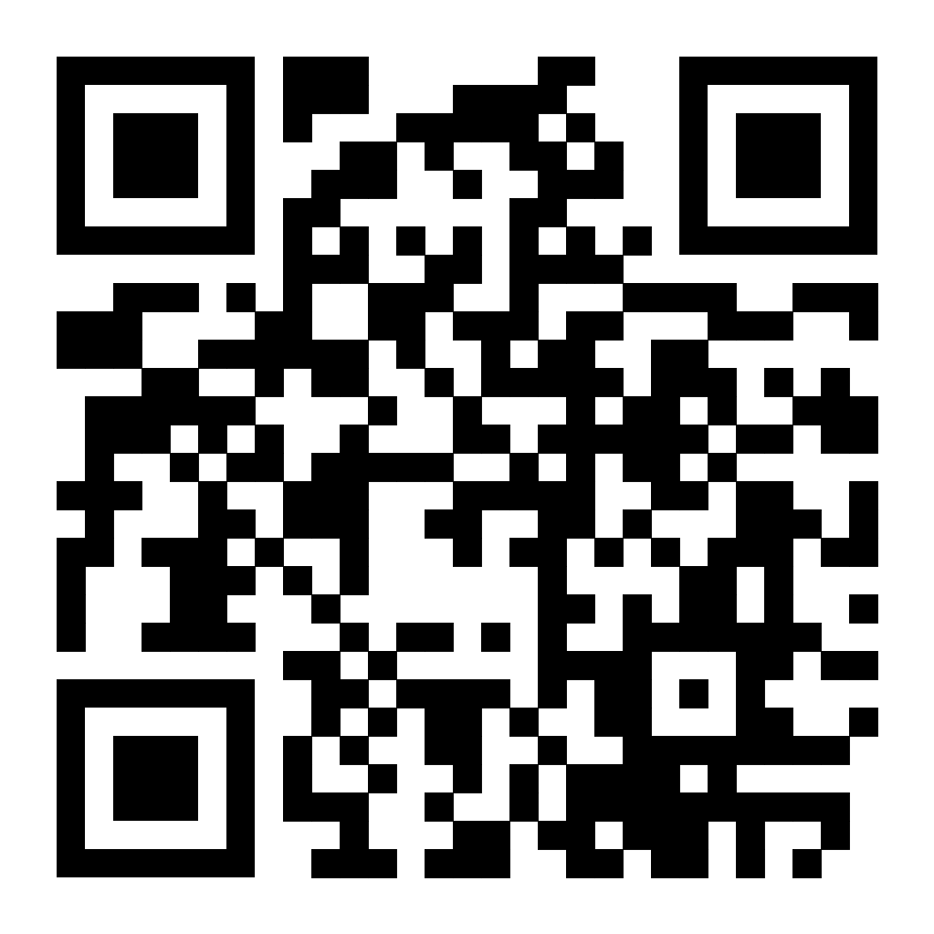
Thank You!
The full report is available at: www.ibo.org/en/research/
If you have additional questions after today, please feel free to email:
Ellen.Sawtell@ibo.org
Jarrett.Stuart@ibo.org

Slide 49
Thank you for attending the session
Please take a moment to fill out the feedback survey for this session.
Visit https://forms.office.com/r/PGfCfckPeW or scan this QR code

